Slide 1
Deep Learning Methods for Solving Partial Differential Equations
MX Computational Analytics Project
Team Members:
Hashim Alsadah
Abdulwahab Alghamdi
Hussain Alsinan
Abstract:

Slide 2
Introduction
Partial differential equations (PDEs) are essential components for modelling different processes and systems in various scientific and engineering areas. Different models have been developed to perform this task such as Physics-Informed Neural Networks (PINNs) and Neural Operator. The speed and the efficiency of these models can surpass other common solvers such as Finite Elements (FM), Finite Difference (FD), and spectral methods in certain cases.

Slide 3
Why Neural Networks?
Based on Universal Approximation Theorem, Neural Networks can approximate PDEs solutions given sufficient number of layers and hidden parameters

Slide 4

Physics Informed Neural Networks
Physics-informed Neural Network (PINN) is the most basic and widely used model for approximating PDEs' solutions. PINN is unsupervised learning model used to approximate the solution of a PDE. PINN incorporate the physical prior knowledge of the problem in the neural network’s (NN) loss function in order to guide the neural network to the optimal approximation by reducing the number of admissible solutions to the problem. A general PDE can be described by the following general equations:
$$ℱ\left(u,θ\right)\left(x, t\right)=f\left(x,t\right) \left[x,t\right]∈Ω (1)$$
$$ℬ\left(u, θ\right)\left(x, t\right)=g\left(t\right) x∈∂Ω (2)$$
$$ℐ\left(u, θ\right)\left(x, t\right)=h\left(x\right) t∈∂Ω_{0} (3)$$

Slide 5
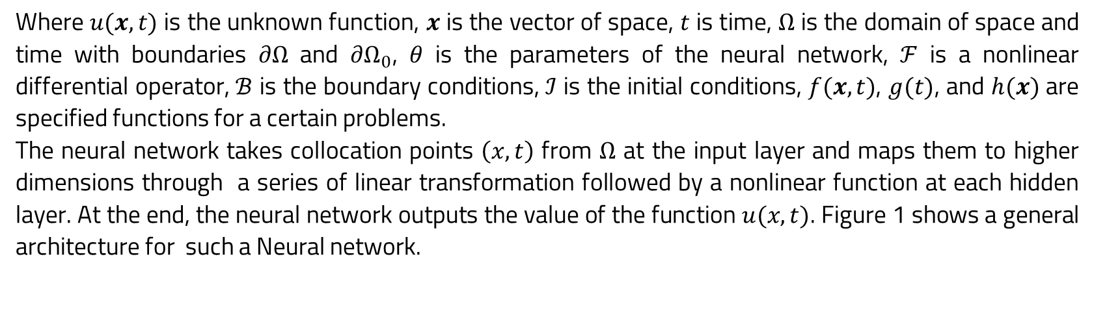

Physics Informed Neural Networks
$$ℱ\left(u,θ\right)\left(x, t\right)=f\left(x,t\right) \left[x,t\right]∈Ω (1)$$
$$ℬ\left(u, θ\right)\left(x, t\right)=g\left(t\right) x∈∂Ω (2)$$
$$ℐ\left(u, θ\right)\left(x, t\right)=h\left(x\right) t∈∂Ω_{0} (3)$$
Where $u(x, t)$ is the unknown function, $x$ is the vector of space, $t$ is time, $Ω$ is the domain of space and time with boundaries $∂Ω$ and $∂Ω_{0}$, $θ$ is the parameters of the neural network, $ℱ$ is a nonlinear differential operator, $ℬ$ is the boundary conditions, $ℐ$ is the initial conditions, $f(x, t)$, $g(t)$, and $h(x)$ are specified functions for a certain problems.
The neural network takes collocation points $\left(x, t\right)$ from $Ω$ at the input layer and maps them to higher dimensions through a series of linear transformation followed by a nonlinear function at each hidden layer. At the end, the neural network outputs the value of the function $u(x,t)$. Figure 1 shows a general architecture for such a Neural network.

Slide 6
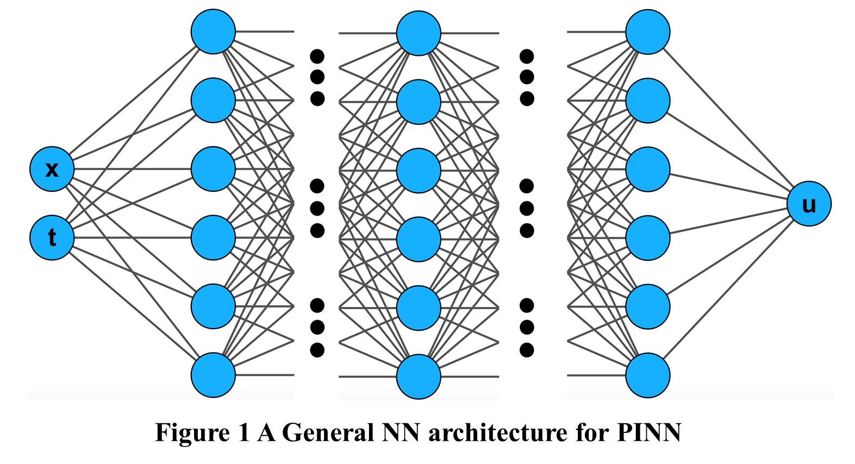
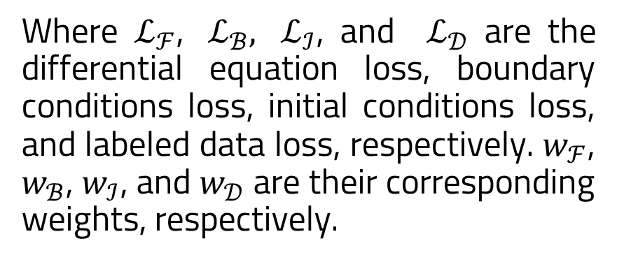
Architecture
The parameters of PINN are updated by minimizing a loss function that incorporates the differential equation and its boundary and initial conditions
Where $ℒ_{ℱ}$, $ℒ_{ℬ}, ℒ_{ℐ}$, and $ℒ_{𝒟}$ are the differential equation loss, boundary conditions loss, initial conditions loss, and labeled data loss, respectively. $w_{ℱ}$, $w_{ℬ}$, $w_{ℐ}$, and $w_{𝒟}$ are their corresponding weights, respectively.

Slide 7
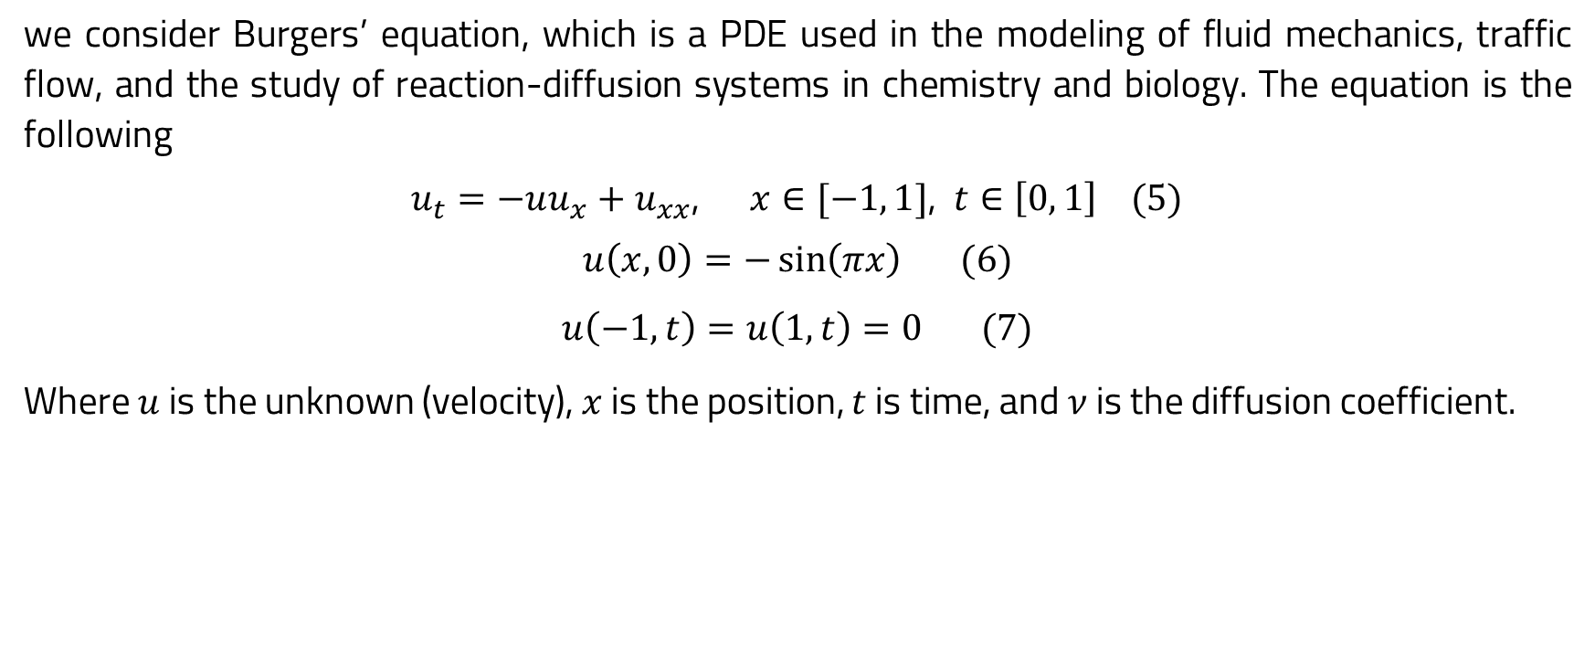
Example
we consider Burgers’ equation, which is a PDE used in the modeling of fluid mechanics, traffic flow, and the study of reaction-diffusion systems in chemistry and biology. The equation is the following
$u_{t}=−uu_{x}+u_{xx}$, $x∈[−1, 1]$, $t∈\left[0, 1\right] (5)$
$$u\left(x,0\right)=−\sin\left(πx\right) (6)$$
$$u\left(−1, t\right)=u\left(1, t\right)=0 (7)$$
Where $u$ is the unknown (velocity), $x$ is the position, $t$ is time, and $ν$ is the diffusion coefficient.

Slide 8
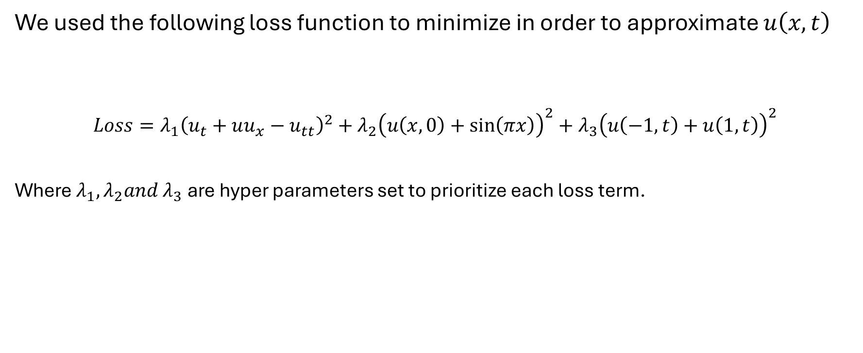
Loss Function
We used the following loss function to minimize in order to approximate $u\left(x,t\right)$
$$Loss=λ_{1}{\left(u_{t}+uu_{x}−u_{tt}\right)}^{2}+λ_{2}{\left(u\left(x,0\right)+sin\left(πx\right)\right)}^{2}+λ_{3}{\left(u\left(−1,t\right)+u\left(1,t\right)\right)}^{2}$$
Where $λ_{1},λ_{2}and λ_{3}$ are hyper parameters set to prioritize each loss term.

Slide 9
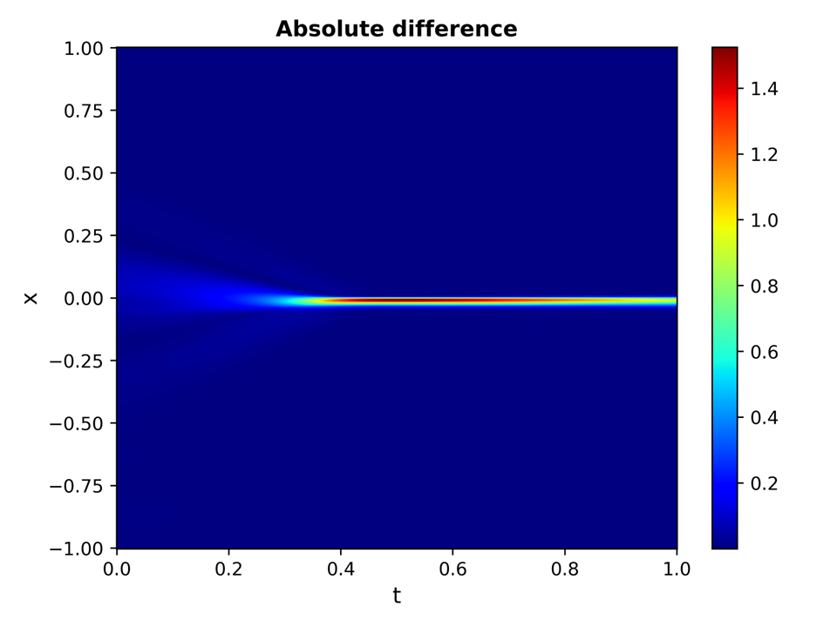
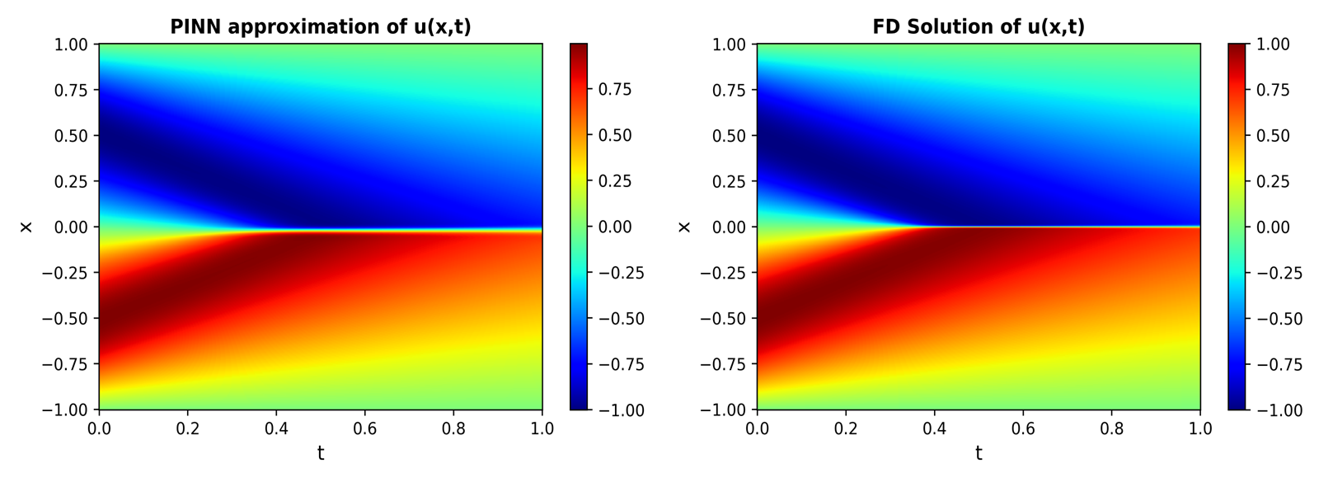
Results

